Slide 1

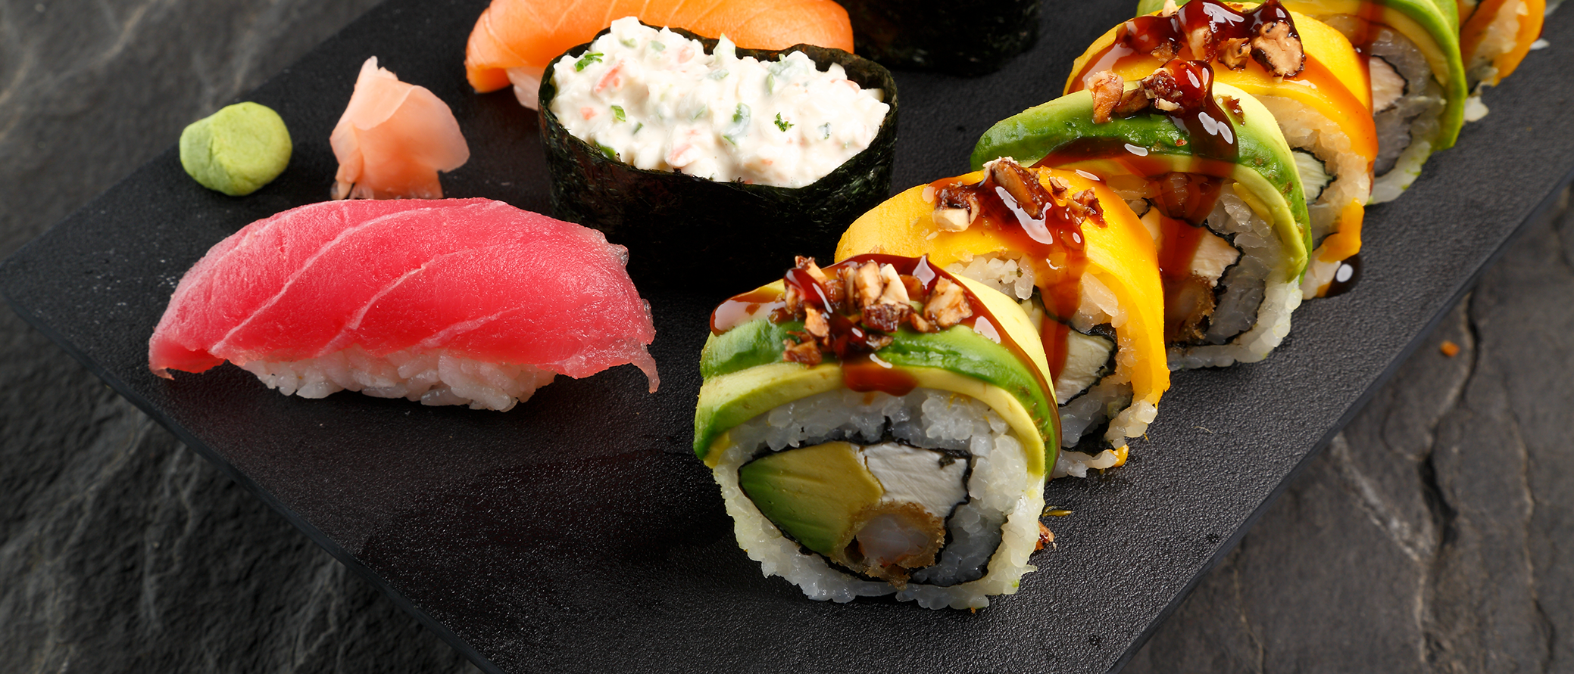
SUSHIROLL
Your Cart
2
Header
Delicious Food, delivered to you
Choose your favorite meal from our broad selection of available meals and enjoy a delicious lunch or dinner at home.
All our meals are cooked with high-quality ingredients, just-in-time and of course by experiences chefs!

Slide 2
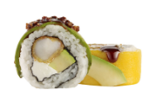

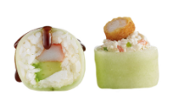
Sunset Roll
Amount
1
Mango, aguacate, nuez caramelizada y salsa de anguila.
+Add
$153.00
Menu
Kushiage Queso
Amount
1
Crujiente brocheta de queso Manchego empanizada.
+Add
$55.00
Inn Roll
Amount
1
Hoja de pepino, Tampico, camarón kushiage y salsa de anguila.
+Add
$153.00

Slide 3
Sunset Roll
Your Cart
-
+
$153.00
x1
Inn Roll
$306.00
-
+
x2
Total Amount
$459.00
Close
Order

